Slide 1




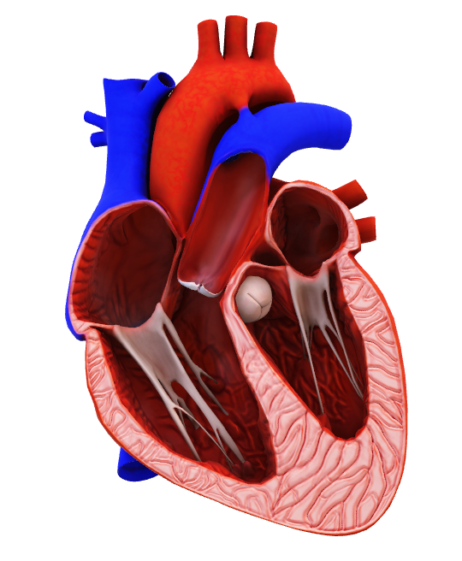

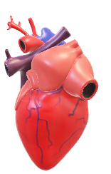
1
Heart Disease Diagnostic Analysis

Slide 2
INTRODUCTION + PROBLEM STATEMENT
2
Heart disease remains one of the leading causes of mortality worldwide, and early diagnosis is critical in preventing severe outcomes like heart attacks and strokes. Analyzing the problem of heart disease diagnosis involves exploring how to effectively identify patients at risk, improve diagnostic methods, and apply statistical and machine learning techniques for more accurate and faster predictions.
Health is real wealth in the pandemic time we all realized the brute effects of covid-19 on all irrespective of any status. You are required to analyze this health and medical data for better future preparation.

Slide 3
Have a Look at Dataset
3
Age- Age of the patient.
Restecg - resting electrocardiographic results with values 0,1,2 it measures heart electrical activity while you're at rest 0 - NORMAL 1 - ST-T WAVE ABNORMALITY 2 - LEFT VENTRICULAR HYPERTROPHY
Thalach - maximum heart rate achieved, a normal thalach is 220 – age.
Exang - exercise induce angina (Stable angina) = a type of chest pain occurs when heart needs more oxygen during physical activity.
Oldpeak - ST depression induced by exercise relative to rest == a condition where the ST segment on an electrocardiogram (ECG) appears lower during physical exertion compared to its level at rest atmost 1 is normal range while more than 2 consider to be more indicative of coronary artery disease.

Slide 4
Have a Look at Dataset
4
Slope - the slope of the peak exercise ST segment 0 - Upsloping , 1 - Flat , 2 – Downsloping.
ca - number of major vessels (0-3) coloured by flourosopy.
Thal - thalasemia(blood disorder) 0 - NORMAL 1 - FIXED DEFFECT 2 - REVERSABLE DEFFECT.
Target - 0 - Normal, 1 - HeartAttack

Slide 5
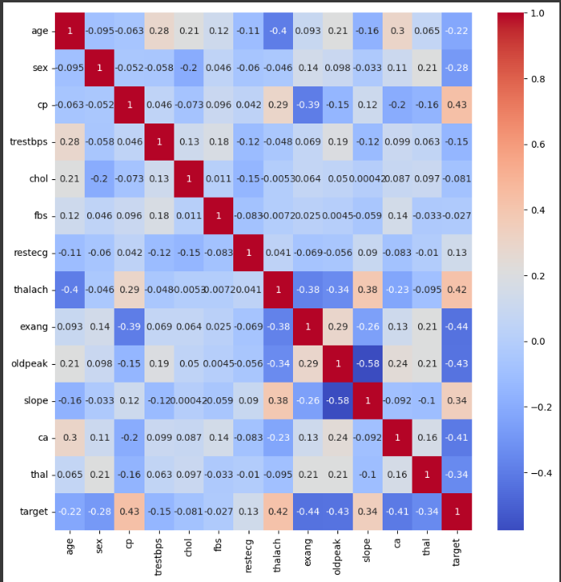
Glimpse over the Data
5
According to the HeatMap CP(chest Pain) and thalach( maximum heart rate achieved ) are causing a great impact on deciding weather a patient will have heart problem or not.
slope and thalach has moderate realation with each other.
exang(exercise induce angina) has opposite impact on target i.e., with decrease in values of exang the cardiac problem is more to inclined.
slope and oldpeak are more dependent in negative correlation.

Slide 6
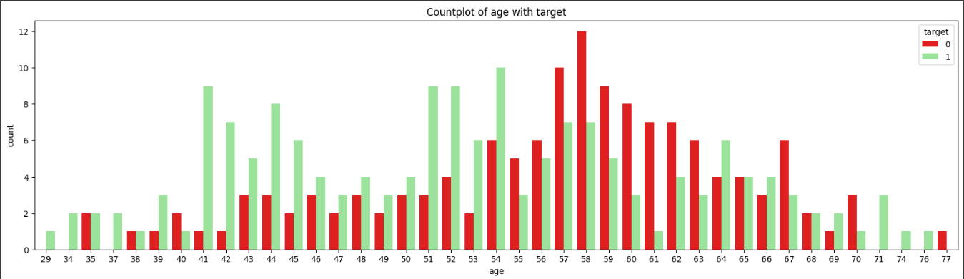
Age Wise Diagnosis
6
This observation tells us that from age 41 to 54 there are cases of heart patient more than any other age group

Slide 7
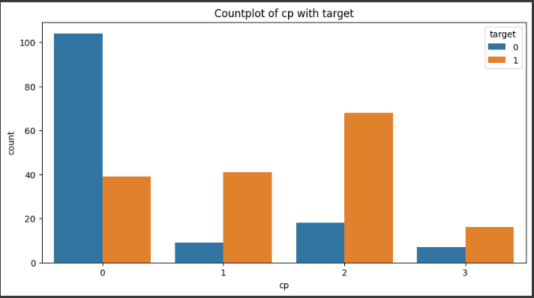
Chest Pain Relativity with # of Patient
7
We can see at chest pain value 1 and 2 there is more likely to be cardiac patient while for chest pain value 0 there is less likely to have heart attack, and for cp = 3 there are very less patient recorded for not having heart problem.

Slide 8
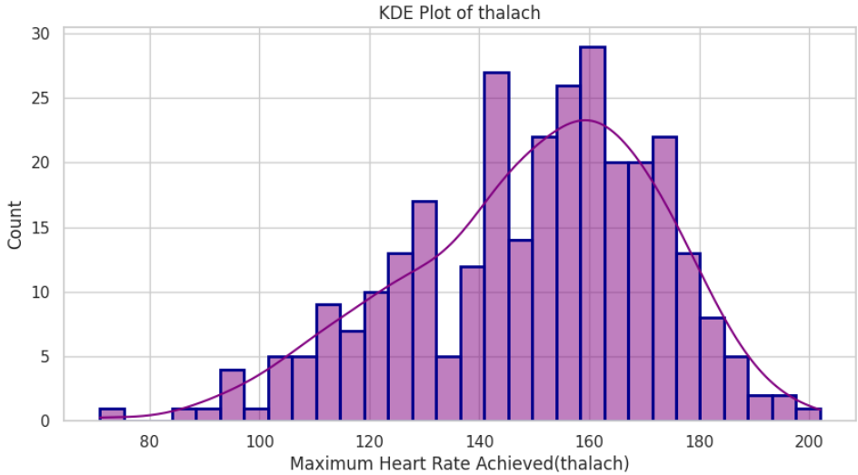
Maximum Heart Rate Distribution in Stress TEST
8
This density distribution for stress test is little skewed towards left, and mostly patients are achieving maximum heart rate of 150 to 170 or 140 bpm
Here we can consider thalach below 90 and above 200 as outliers.

Slide 9
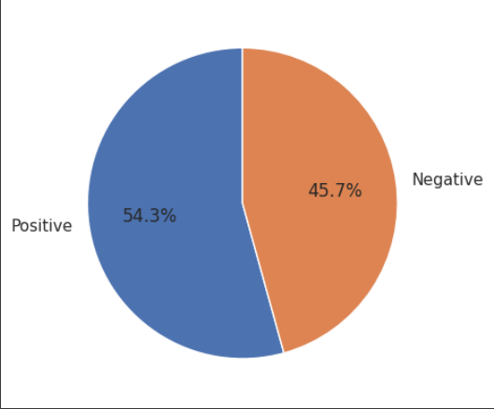
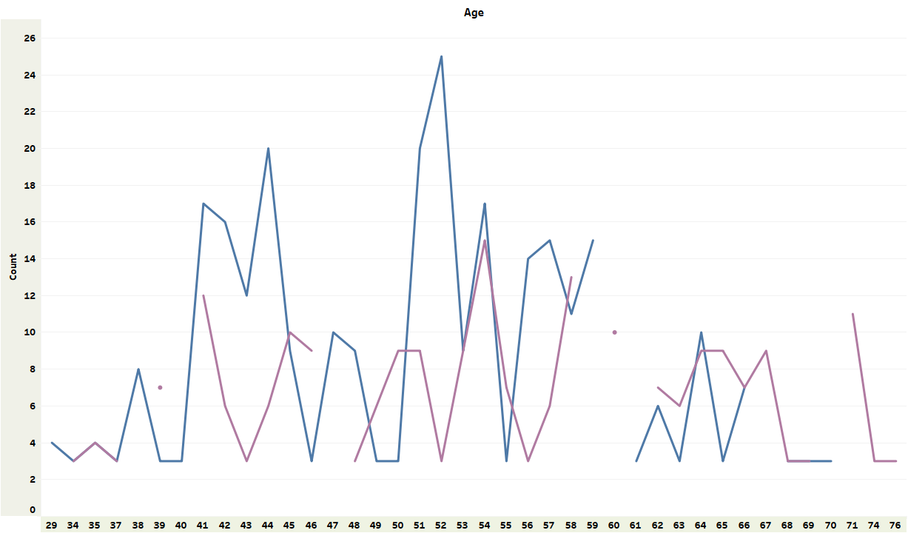
Population wise analysis
9
We can see 54.3% of people are suffering from heart disease.
Males are more vulnerable to heart attack than females.
Males with age group 40 to 60 are having maximum cases.
Females with age gruoup 40-45 and 50-60 are having maximum cases.

Slide 10
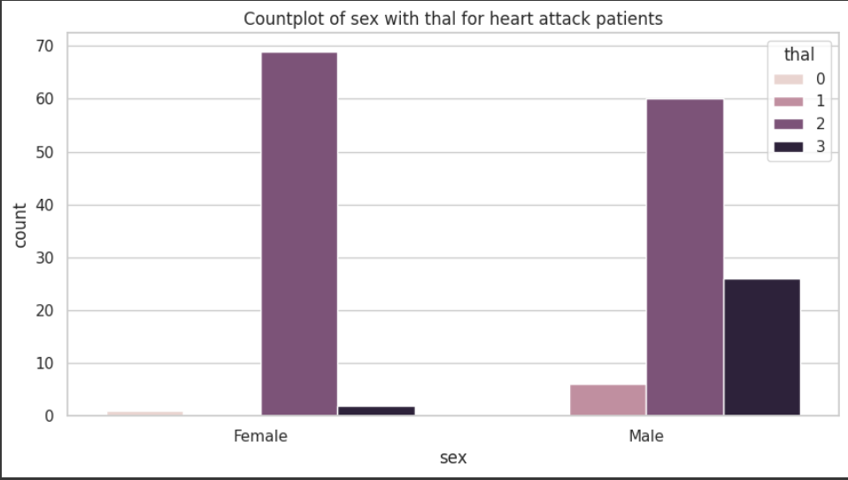
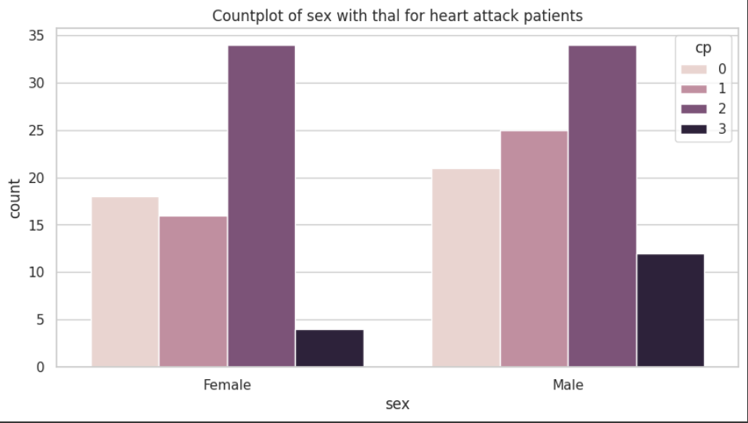
Chest Pain and Blood Disorder
10
The female with blood disorder are highly chanced to have heart attack.
The male with blood disorder with last stage need immediate diagnosis
The Male with chest pain need immediate attention.
The male and female having chest pain stage 2 should be diagnosed.

Slide 11
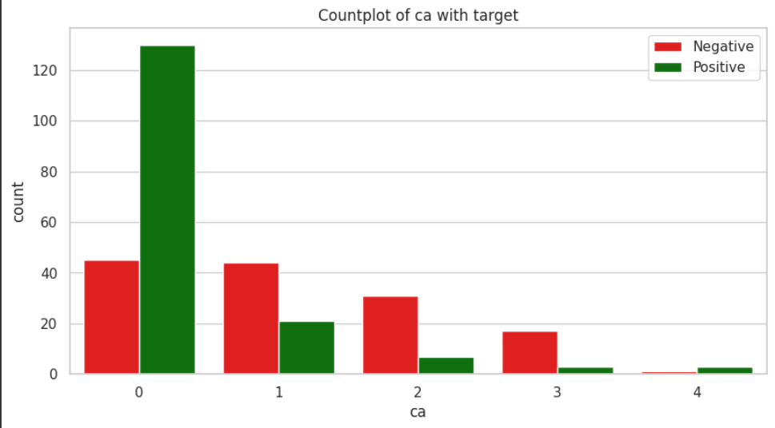
Number of Blocked Major Vessels
11
There are more cases of heart attack with number of blocked vessels atleast 1 and maximum cases with 3 blocked nerves.

Slide 12
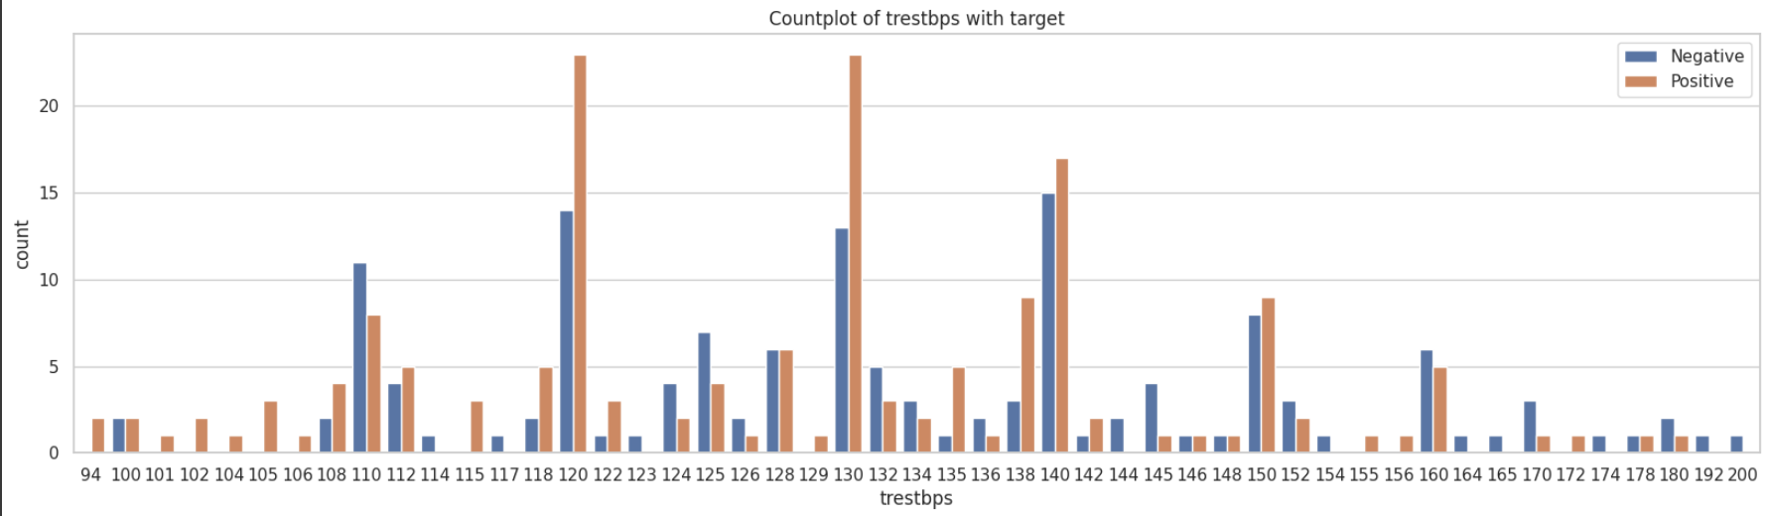
Resting Blood Pressure
12
People with resting blood pressure ranges from 130 to 140 and 120 bps have positive diagnosis while too much less resting bp like 90 to 112 also cause heart issues.
There are maximum people near 130 to 131 bp.

Slide 13
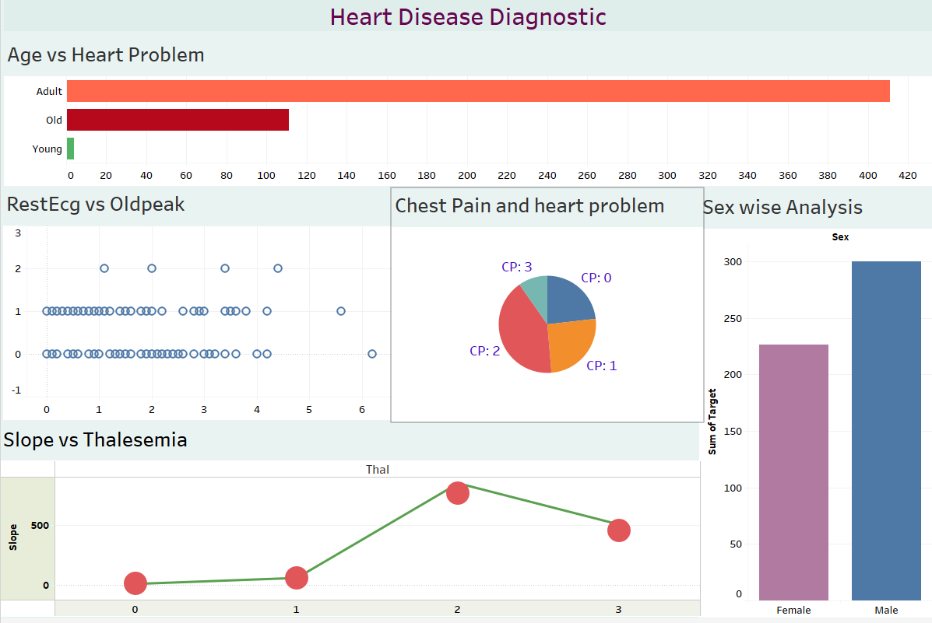
13
DASHBOARD

Slide 14
CONCLUSION
14
Chest Pain (CP) and Maximum Heart Rate Achieved (thalach) are the most significant predictors of heart disease.
Age, gender, blood disorders, and specific resting blood pressure ranges are additional risk factors.
Early detection and intervention are crucial for preventing severe heart disease complications.
It is recommended to prioritize individuals with CP=1 or 2 for further evaluation, implement lifestyle modifications to reduce risk factors, and conduct regular health checkups, especially for those in high-risk groups.

Slide 15
THANK YOU

